Slide 1
4
The inconvenience of personalisation in massively provided guidance services
Case studies from FR and SK
CBS 2020, 30/09/2020
Tomáš Šprlák
tomas.sprlak@gmail.com
Notes:
My name is Tomas and I currently work as a service manager of public guidance services for working adults in France. Previously I worked at Slovak public employment service in the department of guidance and training. Today I hope to bring you some perspectives on how to reconcile the ambition of guidance (a tool for emancipation and empowerment, fundamentally tailored to the needs of the clients) with the requirements of previsible management and funding system. So it is in a way a question of hot to put a rigid frame on flexible things, objectivate the subjective.
Echanges Dimitri:
Enjeux: c’est quoi la fin du parcours? C’est qui l’indicateur? C’est à l’initiative du bénéficiaire, quand il n’y a plus d’échanges au bout d’un certain temps, le parcours est fini.
Comment répondre au cahier des charges en le consolider avec le pilotage, financement?
Qu’est-ce qu’il doit bouger dans le cahier des charges.
Comment faire pour objective le subjectif? Les accompagnements sont toujours subjectifs, pas le même degree d’autonomie… Cadre objectif dans lequel on met les choses mouvantes. Cadre dans lequel il y a de la liberté.
Rajouter: BdC cadre méthodologique plus rigide par rapport au CEP, plan d’action “démerdez vous”. Dans le CEP, on peut être dans l’assistance.
Problème de recous au service dans le CEP – comment passer de l’information à l’accompagnement.

Slide 2
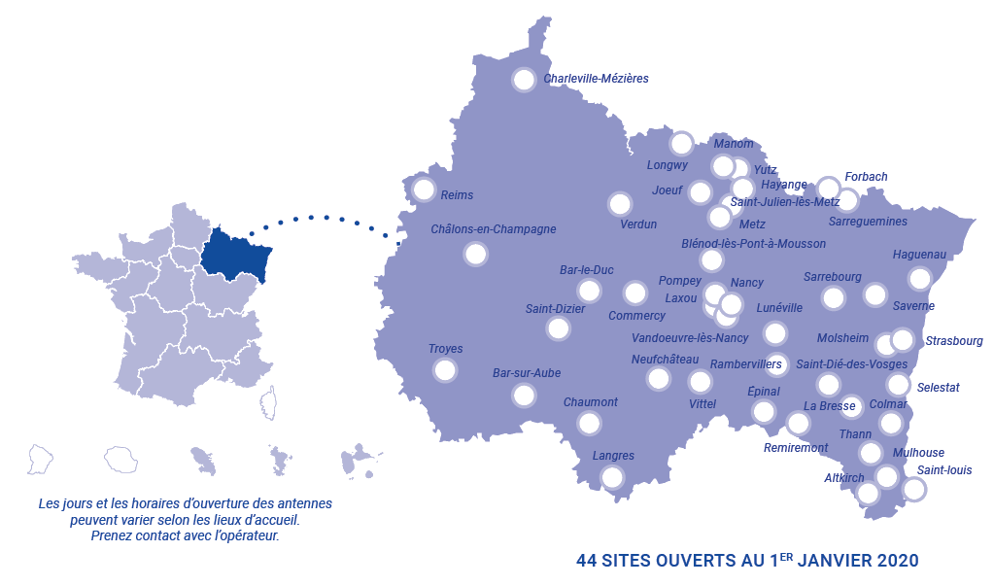
4
Presentation of the service
French umbrella public guidance service for adults
Created in 2014 in order to streamline existing services and facilitate the acces of citizens
5 operators for different target groups (PES, youth centres, centres for disabled people)
Since 01/01/2020: service for working adults delegated to private contractors on the regional basis

Slide 3
4
Principles and objectives
Fluidification of the pathways and decompartmentalization of systems and actors
Co-construction of the objectives and of the pathway
Initiative of the user (on demand)
Capability approach (Amartya Sen) – facilitate access to all existing services

Slide 4
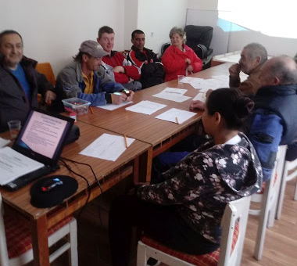
4
Presentation of the service
External guidance provision by private contractors of the national PES in Slovakia
ESF-funded project in preparation since 2013, launched in 2019
Previsions 2019 - 2021: 30 000 long term unemployed go through the programme

Slide 5
4
Principles and objectives
Development of career management and jobseeking skills - employability
Identification of realistic employment objectives in accordance with skills, motivations, personal characteristic and the situation of the jobseeker
Methodologically inspired by the french tradition of „bilan de compétences“ (skills audit) – with residual elements of the matching approach
Selection of candidates by the employment counsellors - prescription
Notes:
Mandatory participation

Slide 6
Course of the service
Type of activity | Form | Duration
Initial information meeting | workshop | 4h
Intake interview | Individual | 1h
My interests and my strengths | workshop | 6h
My experiences and my skills | workshop | 6h
My career goal | individual | 1h
Jobseeking techniques | workshop | 6h
My action plan | individual | 1h
Group action plan coaching | workshop | 6h
Final interview | individual | 1h
Monitoring interview (1 month later) | workshop | 6h
38h
8 – 12 weeks

Slide 7
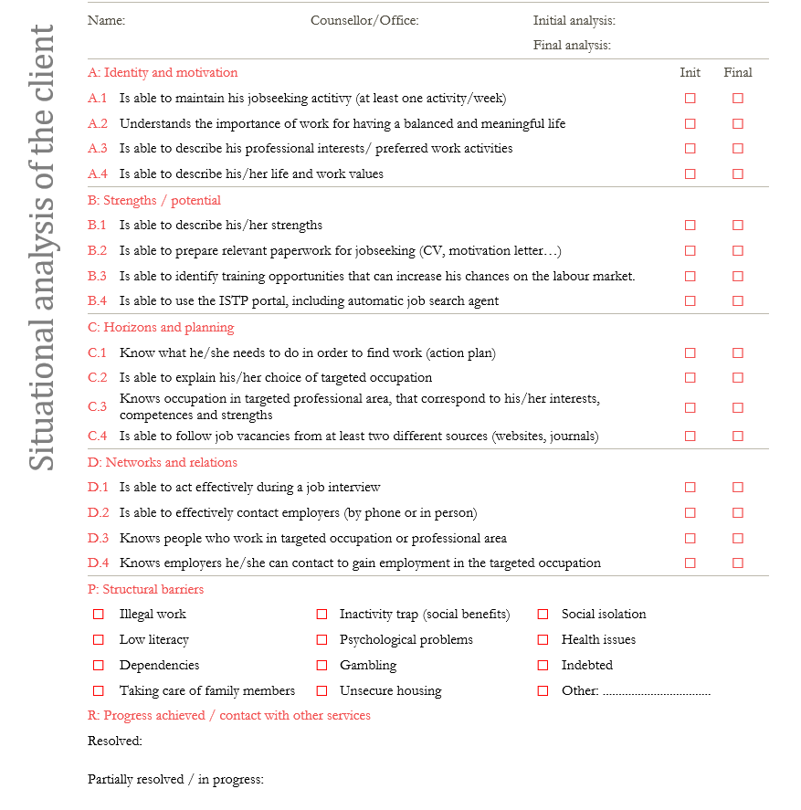
Personalisation
CMS checklist: Co-analysis of client’s situation before and after the service
Used for the identification of client’s needs and assessment of the impact of guidance services
Personnalisation within the pre-defined course
Focus on objective and observable indicators
Notes:
Mandatory participation

Slide 8
Course of the service
4
Appointment with a counsellor
U0. Referral
10min
1st level guidance
2h in average
2 months max
U1. Co-analysis of the situation
2nd level guidance
U2.1. Personalized counselling
Formalisation of a career goal
4h in average
6 months
18 months max
U2.2. Personalized counselling
Implementation of the career goal
2h in average
UO2.2 impossible if no UO2.1
8h avrg.
18m max
Possibility to start the service directly in U1 or directly in U2.1

Slide 9
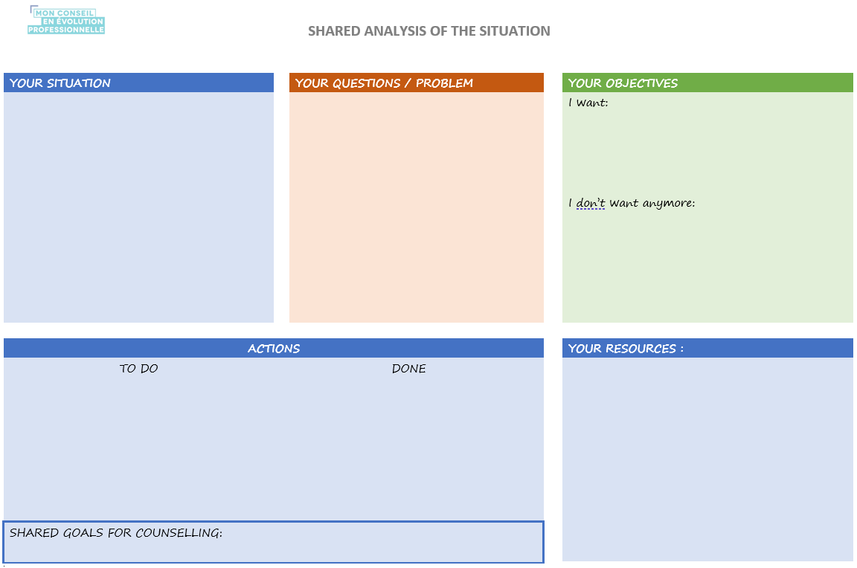
Personalisation
Shared approach to first interview by all operators: “Shared analysis of the situation”
Goal: allow the client to express need, gain better understanding of the situation, goals and levers for action
Methodology: co-construction
Focus on subjective perception of the client
Written practice (life space mapping…)
Decision of the client on the kind of support he/she needs
Notes:
Mandatory participation(constructivist conception of language)

Slide 10
Service management
Payment per hour
Performance indicators: development of CMS, placement rate – focus on outcomes
Payment per final report for every Unit
+ user satisfaction and reports quality bonus
+ quarterly payments for service management
+ service promotion, partnership development and system integration
Performance indicators: number of users, structure of users, use of complimentary services, quality of the final reports, duration of different levels of service – focus of outputs
No “pay per result”
Notes:
Mandatory participation

Slide 11
Promoting the voice of the client ?
Access to service | On demand access whenever possible If not possible, separate prescription from provision
Goals | Do not restrict goals, so that the service can respond to various career-development needs of the citizens Focus on the final goal: empowerment of citizens
Methodology | Embed methodological principles into official documents such as procurement specification, decrees, documents Explicit focus on user’s need analysis as a starting point of every pathway
Design of the service | Modularize the service to allow flexible use (with deliverable per module)
Funding | Payment per deliverable (not per duration) Motivate providers to develop the service and its quality (payments for CPD, promotion, user satisfaction, system integration…)
Evaluation | “Pay per output” seems to allow for more openness to clients’ needs than “pay per outcome”? Focus on quality evaluation (mystery shopping, building relations with providers, user satisfaction) rather than result evaluation
Notes:
Language constructs reality

Slide 12
4
Thank you for your attention
CBS 2020, 30/09/2020
Tomáš Šprlák
tomas.sprlak@gmail.com

